Slide 1
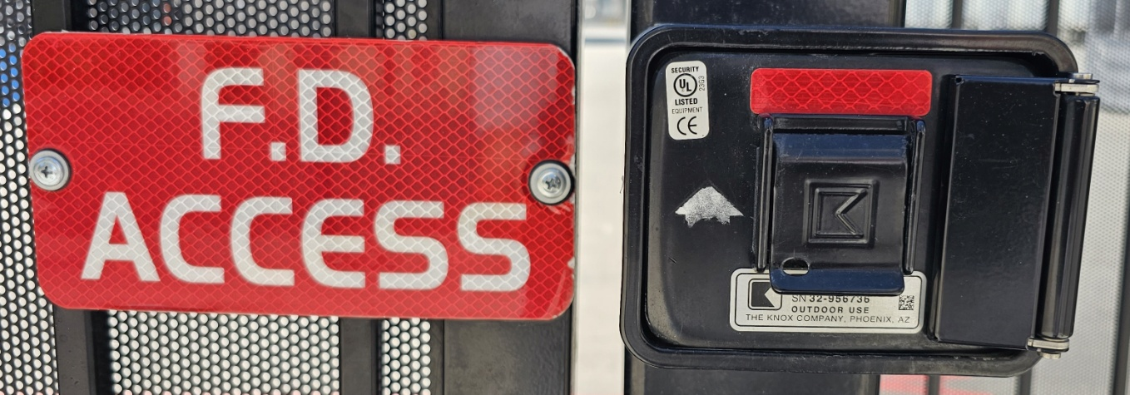
The Knox Box:
A Brief History
This talk is not affiliated with or endorsed by Knox. All information is publically available, based on original research by individuals not employed by Knox at the time of research, and/or not based on trade secrets.

Slide 2
What is a “Knox Box”?
“Knox” is a trademark owned by Knox & Associates and/or its affiliated entities.
The term “Knox Box” is the ubiquitous (but still trademarked) name for any of a series of physical key escrow vaults affixed to structures for the purpose of providing rapid access to physical and/or logical credentials for emergency services such as fire brigades, police, and/or EMS, etc.

Slide 3
Forged from Fire
Knox was founded by Don Trempala, the property manager for a large residential complex
Don was frustrated that he was called to provide keys to open any unit when emergency services was called, and/or that he had to have doors, etc. replaced if an emergency necessitated destructive entry
Don developed the first Knox Box to provide access to emergency responders without needing his assistance

Slide 4
From John Wayne to Sky Harbor
Knox Boxes were produced in Irvine, CA for many years until manufacturing was moved to Deer Valley in Phoenix, AZ
Knox Boxes can often be dated by their indicated manufacturing origin

Slide 5
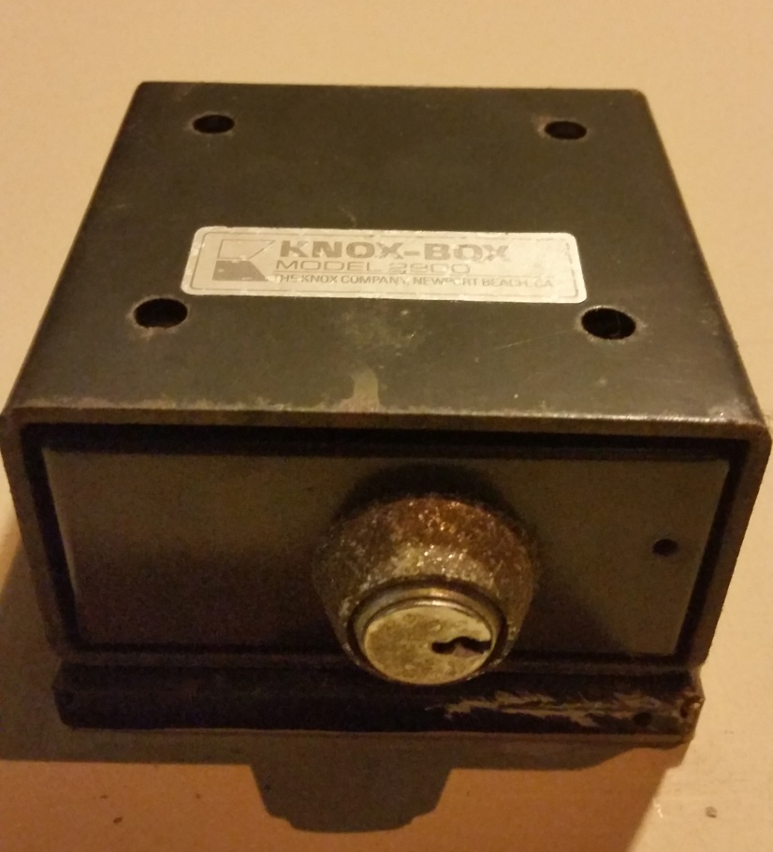
The Original Knox Box
Original Knox Boxes were drawer-style with a small cam:

Slide 6
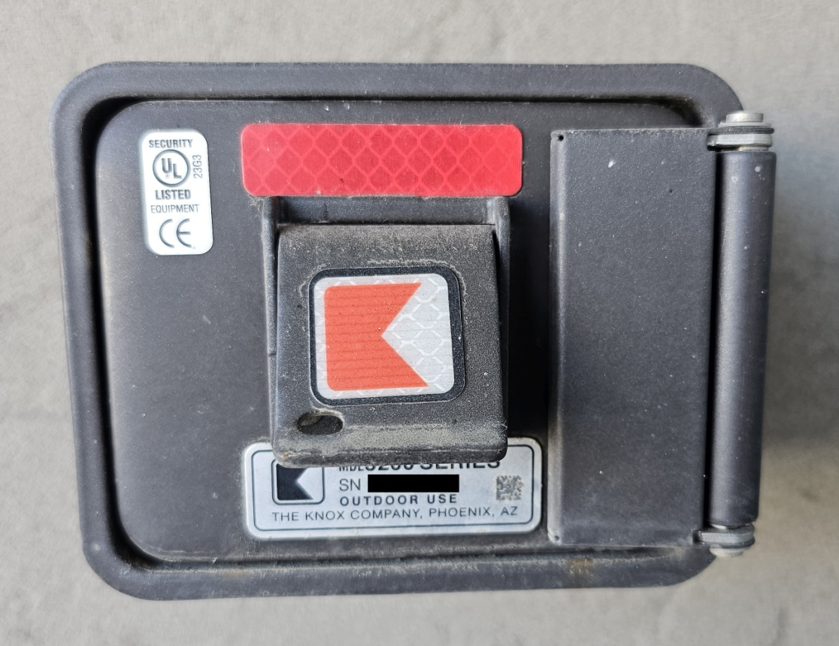
The Knox 3200 Series
The modern Knox 3200 is by far the most recognisable and deployed rapid entry system in the United States

Slide 7
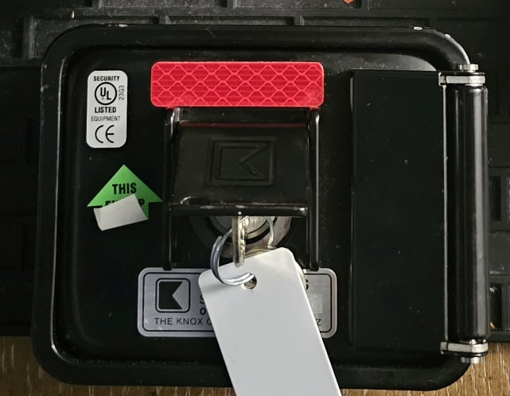
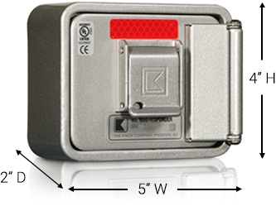
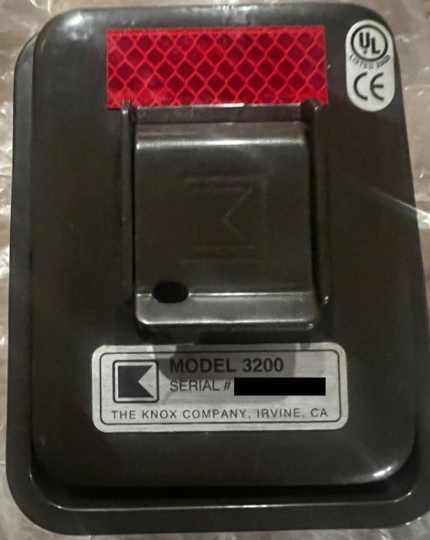
The Knox 3200 Series
The 3200 series are formed from 16ga cold-rolled tubular steel and coated with “Knox coat”, a proprietary (and exceedingly effective) protective shell available in bronze, black, or aluminium

Slide 8
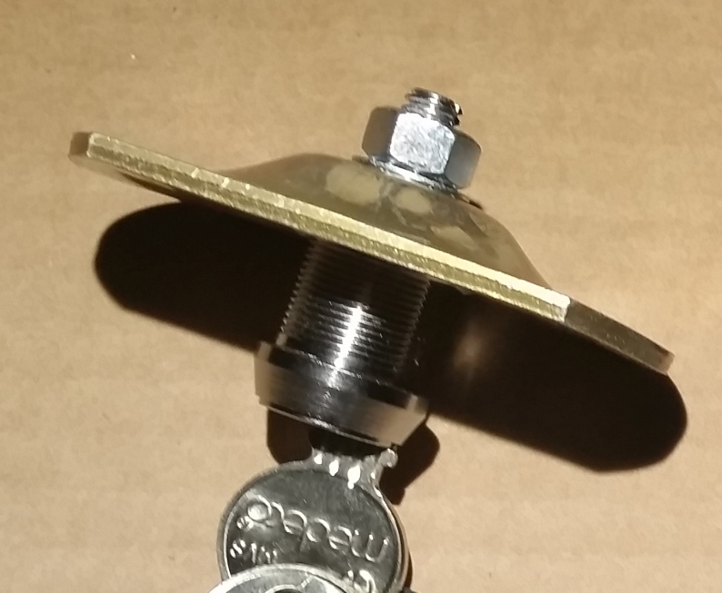
I Cam, I Saw
Original Knox Boxes were drawer-style with a smaller cam, but the 3200 introduced a larger cam for additional security
Subsequent Medeco cam locks feature a larger tail to accommodate the greater torque required to operate the larger cam

Slide 9
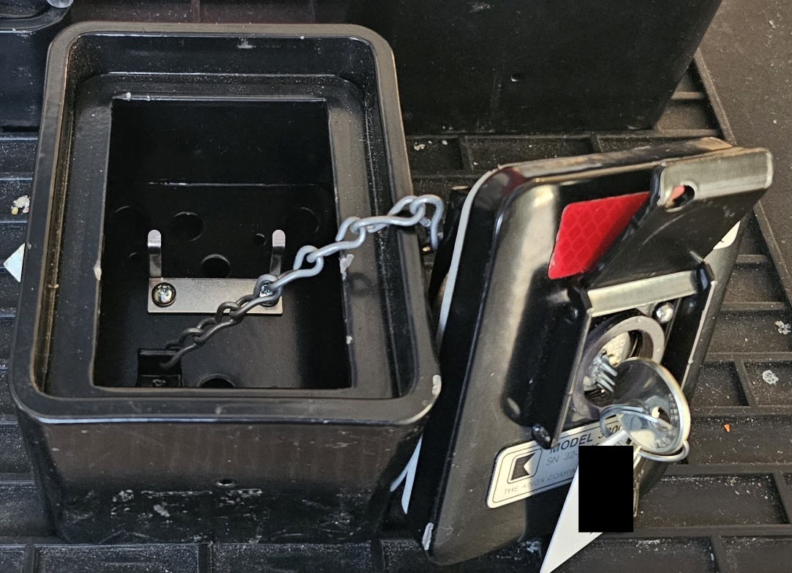
3...2...1... Lift-Off
Eventually the 3200 series was introduced with a lift-off lid, attached by a chain to the interior

Slide 10
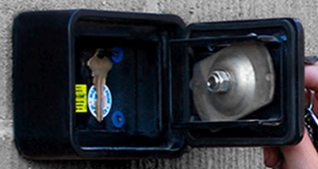
Unhinged
Modern 3200s feature an external hinge, introduced to eliminate the possibility of mis-placing the front plate
The hinges do not provide any additional security to the box and if compromised or removed are inconsequential

Slide 11
The Power of Dissuasion
All 3200 and 4400 series are available in surface (protruding) or recessed (flush) mount styles
Knox makes several recommendations regarding installation to deter attempts at compromise:
Install boxes 8 feet (2.44m) above ground level
Use 8” (20.32cm) bolts into structural components
Connect the tamper switch! (It’s estimated that less than 2% of Knox Boxes purchased with a wired tamper switch have it connected)

Slide 12
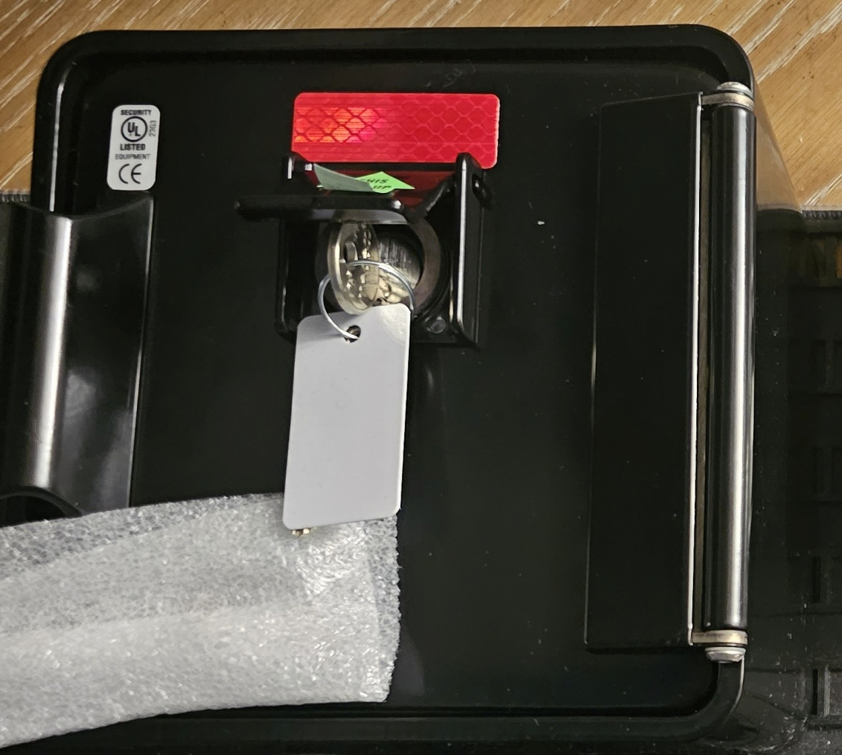
The Knox 4400 Series
The Knox 4400 is intended for larger facilities that may need more physical key storage, or multi-party access

Slide 13
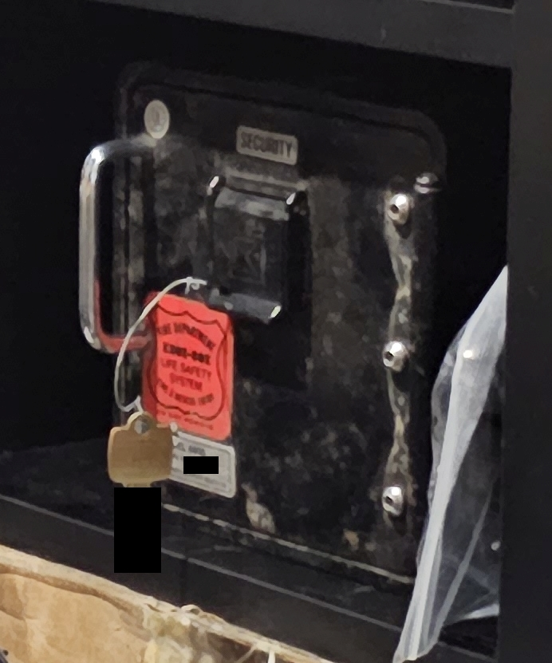
The Knox 4400 Series
An older style 4400 with the hinge cover plate removed

Slide 14
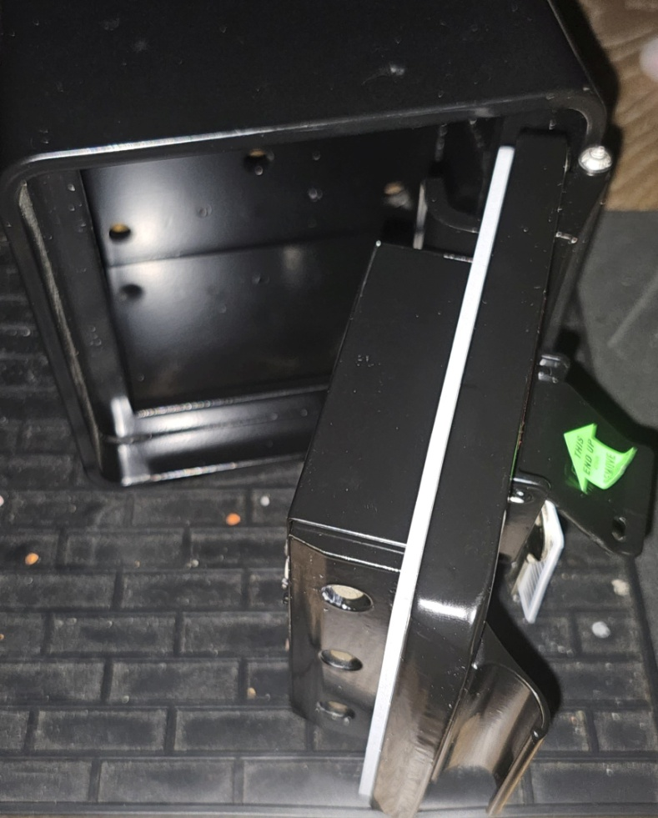
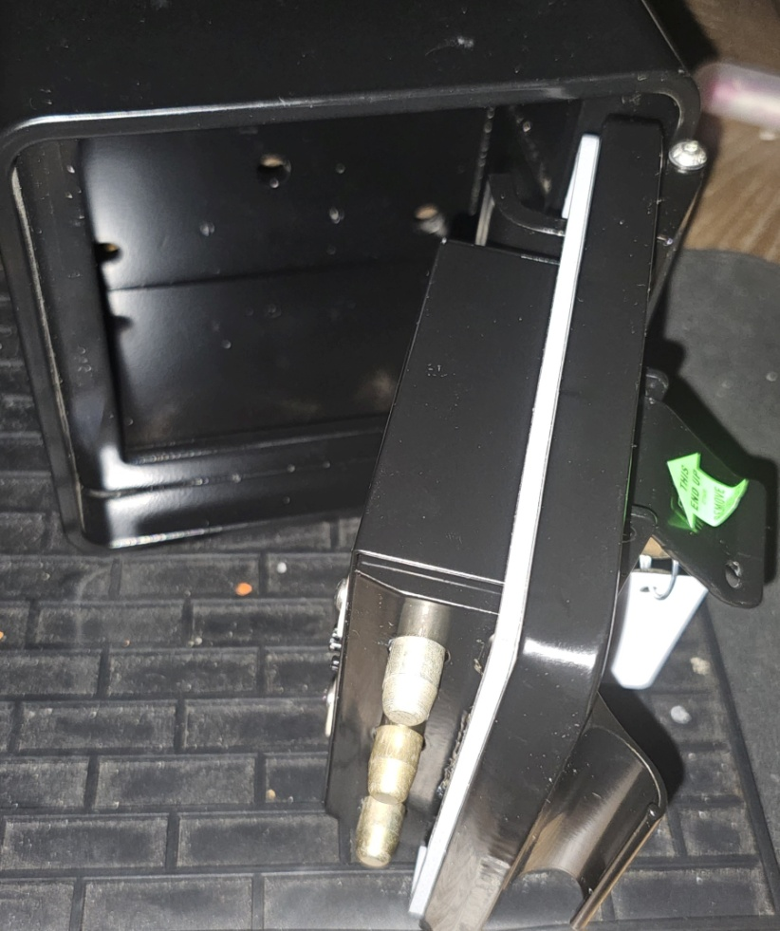
The Knox 4400 Series
The 4400 uses an entirely different securing mechanism, with a hidden relocker feature

Slide 15
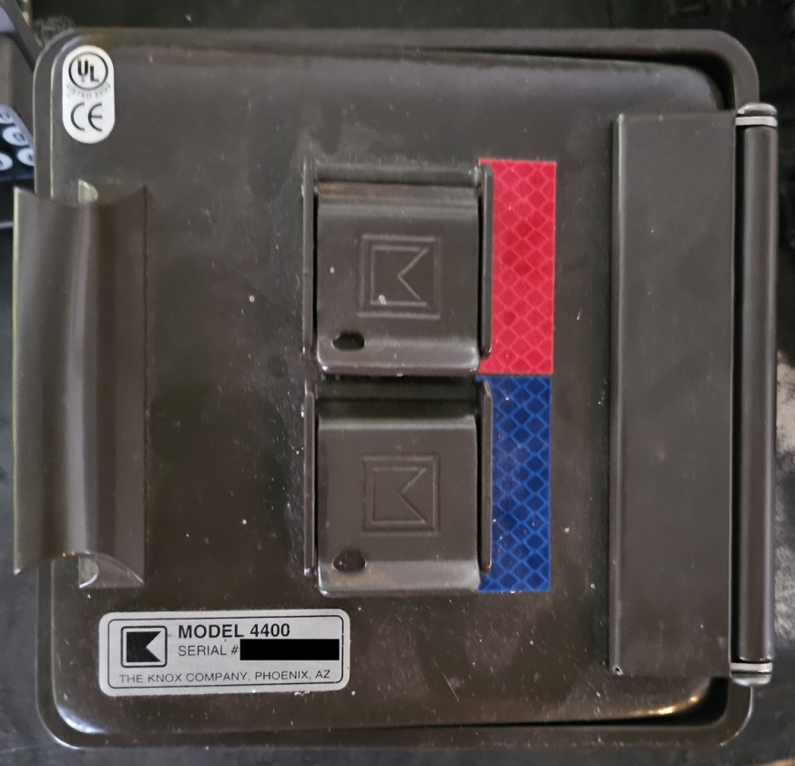
The Knox 4400 Series
The 4400 is available in dual-control configurations:
independent (either key opens) or
cooperative (both keys required to open)

Slide 16
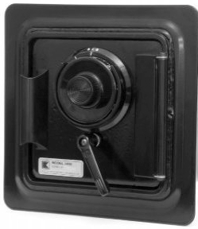
The Knox 4400 Series
The 4400 is (was?) also available with an S&G combination dial
This option is not listed on any recent pricing sheet

Slide 17
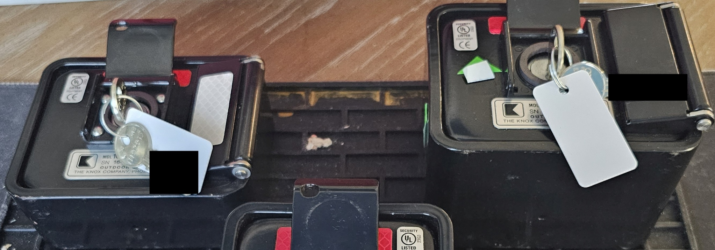
The Knox 1650 Series
The 1650 was introduced for residential applications where a limited depth was preferable but is otherwise practically identical to the 3200

Slide 18

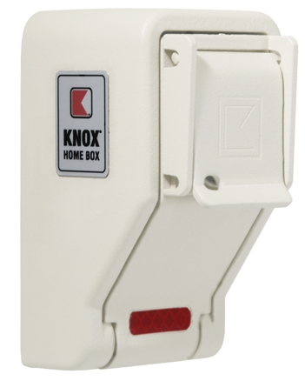
The Knox Home Box
The Home Box holds a single residential key (KW/SC size) and is not practical for much of anything

Slide 19
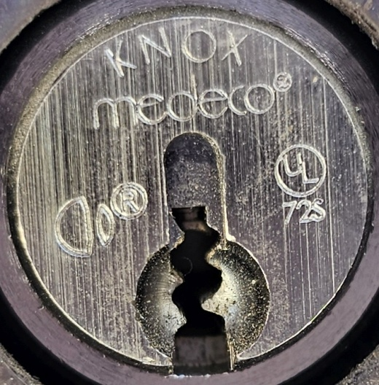
Jurisdiction
Every jurisdiction that uses Knox Boxes has its own key bitting using a Knox restricted keyway
Knox maintains a secure key library of >10,000 jurisdictions in the US and Canada
Jurisdictions are usually defined as a county, city, or district, but are occasionally assigned by service type (fire / police / EMS / etc.)

Slide 20
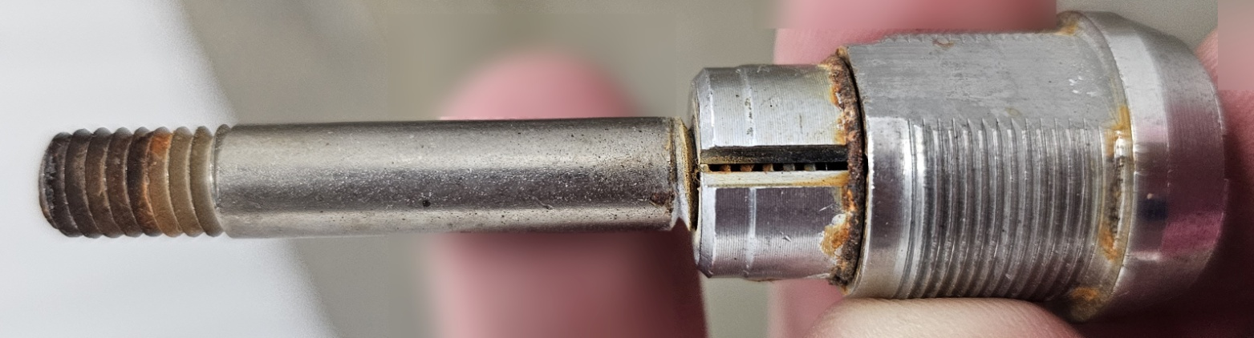
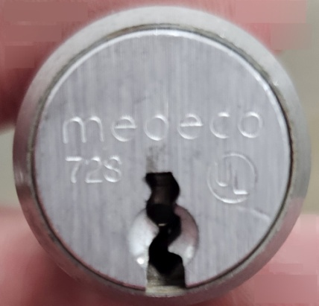
Tech Locks
Every jurisdiction is assigned a bitting for a jurisdictional access key and a “tech” key, used to secure interior components of KeySecures, MedVaults, etc.
The tech lock core is a Medeco cam lock with an additional component attached (Note that the sidebar resets every 90 degrees on the tech lock)

Slide 21
Knox and Medeco
From the beginning, a high degree of security for the box lock was required to prevent unauthorised access to the contents
Medeco lock cores were chosen and have been used in almost all Knox products until the release of the Knox eLock
Knox has paced, and at times driven, the development of new security features in Medeco locks
Knox were early adopters of Medeco Biaxial and M3 security features

Slide 22
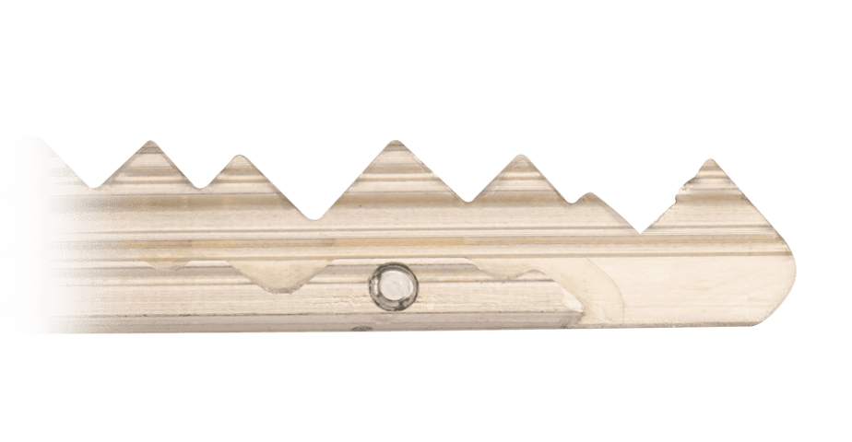
Knox and Medeco
Some features of Medeco lock cores have been unique to Knox until included in future Medeco generations.
The shuttle pin of the Medeco M4 was used by (and may have been developed for) Knox for many years before the M4 was released.

Slide 23
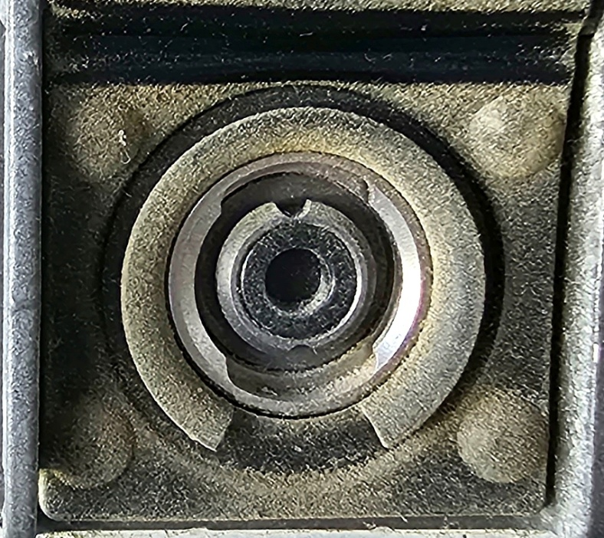
The Knox eLock
Knox worked for years to develop an electronic lock to eventually replace physical keys and cores
The eLock is an intriguing design that was introduced in 2021 and is a drop-in replacement for Knox Medeco locks

Slide 24
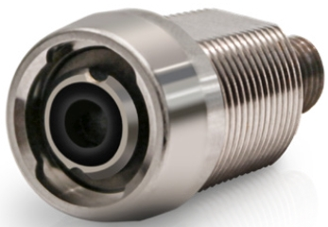
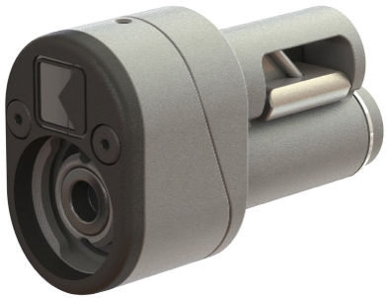
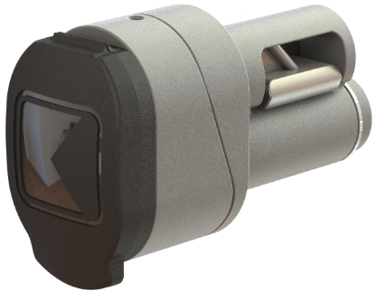
The Knox eLock Core
eLock Cam Core
eLock SFIC Indoor
eLock SFIC Outdoor

Slide 25
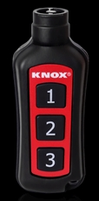
The Knox eKey
The eKey (according to the patent) uses induction to power the lock from the key’s battery
The eLock also provides auditing and granular controls not available in mechanical locks

Slide 26
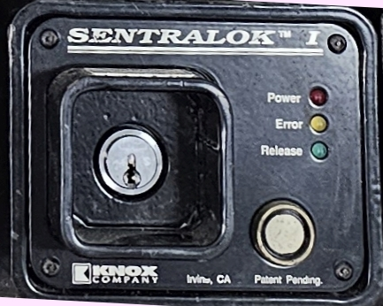
Knox Key Control Systems
SentraLok

Slide 27
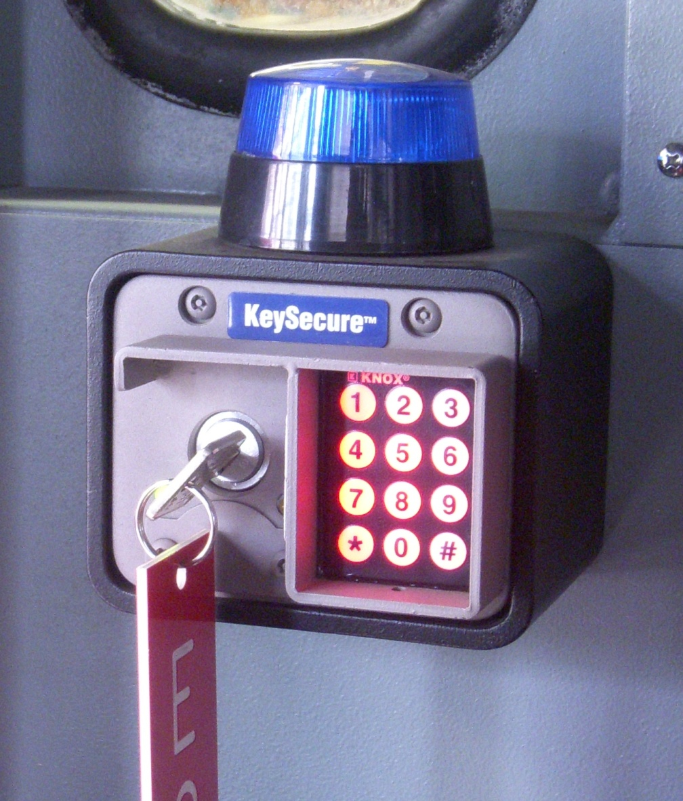
Knox Key Control Systems
KeySecure

Slide 28
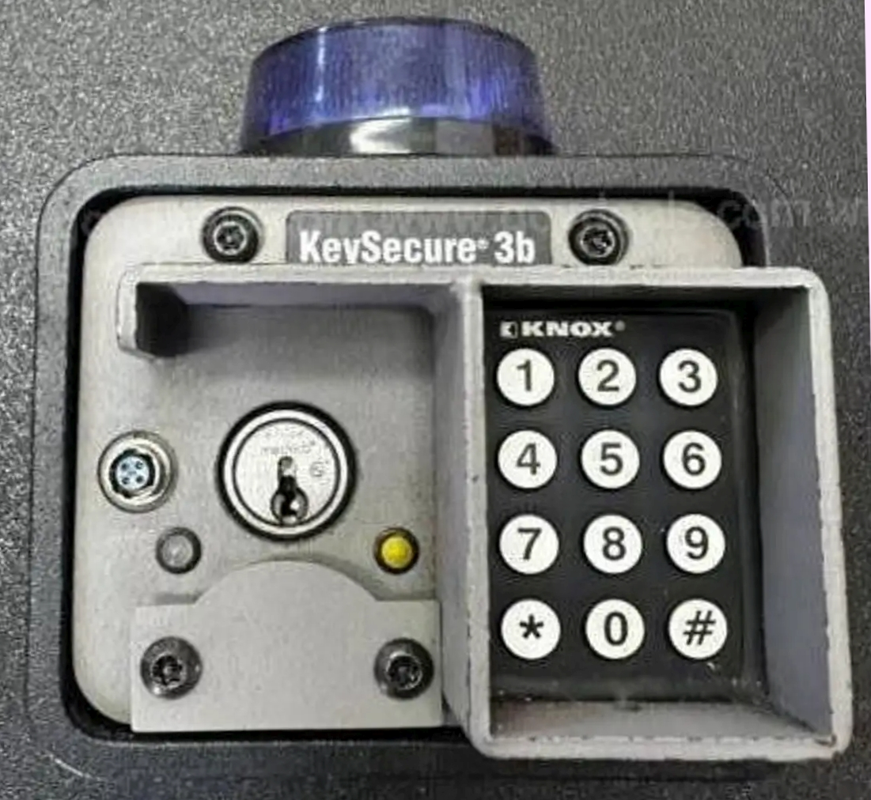
Knox Key Control Systems
KeySecure 3b

Slide 29
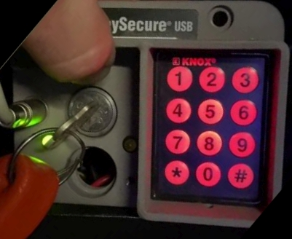
Knox Key Control Systems
KeySecure USB

Slide 30
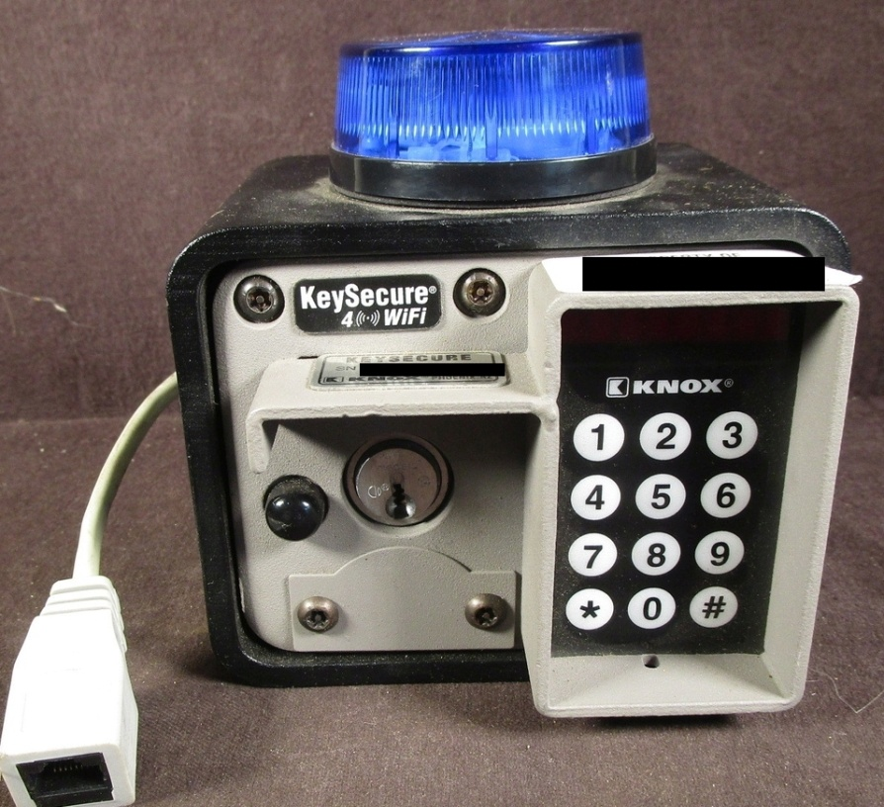
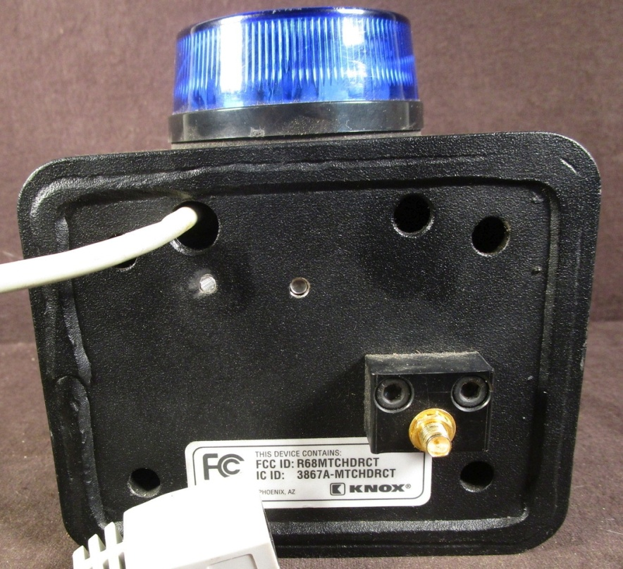
Knox Key Control Systems
KeySecure 4 Wi-Fi

Slide 31
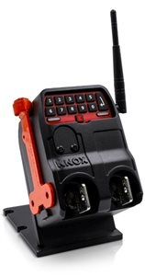
Knox Key Control Systems
KeySecure 5

Slide 32
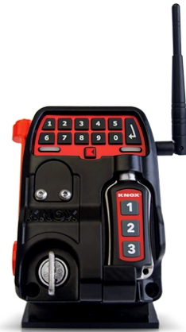
Knox Key Control Systems
KeySecure 6

Slide 33
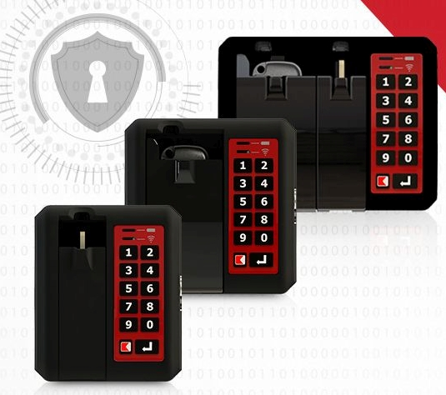
Knox Key Control Systems
KeyDefender

Slide 34
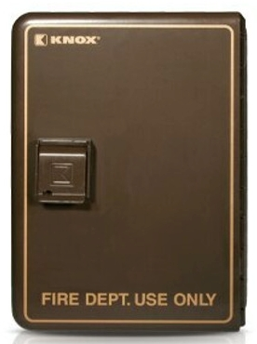
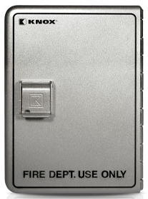
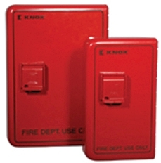
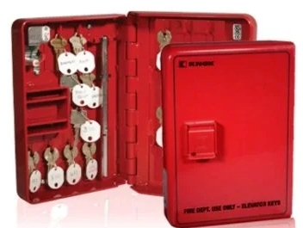
Knox Document Storage
Elevator Boxen

Slide 35
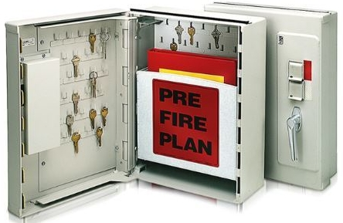
Knox Document Storage
Knox 1300 Cabinet

Slide 36
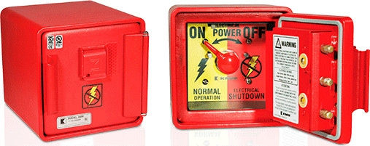
Power Up
Knox Power Control

Slide 37
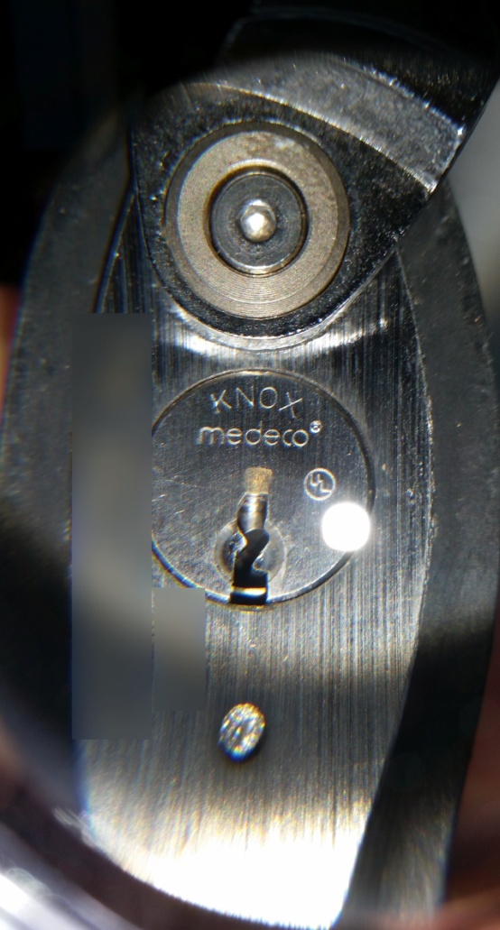
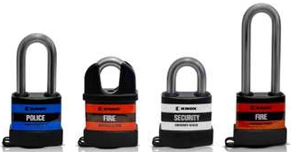
Knox Padlocks

Slide 38
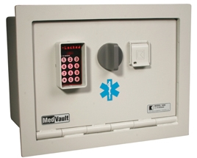
Knox MedVaults
Knox MedVault I

Slide 39
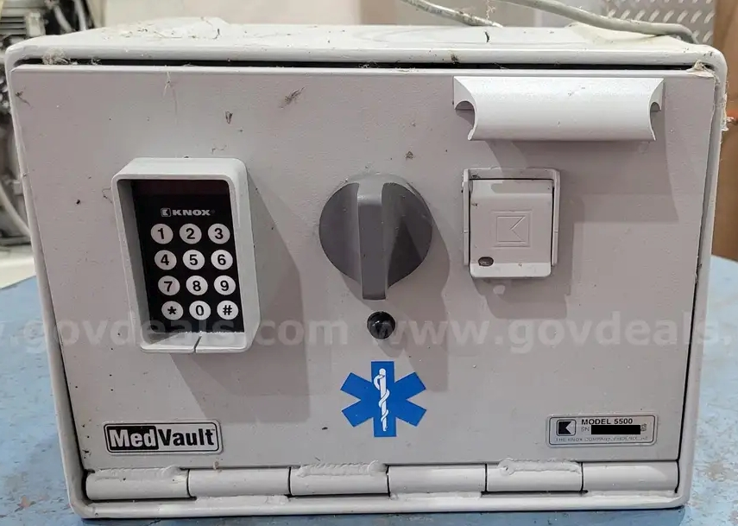
Knox MedVaults
Knox MedVault 5500 (MedVault 2)

Slide 40
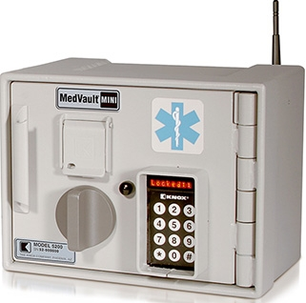
Knox MedVaults
Knox MedVault Mini

Slide 41
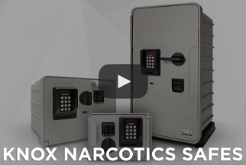
Knox Narcotics Safes

Slide 42
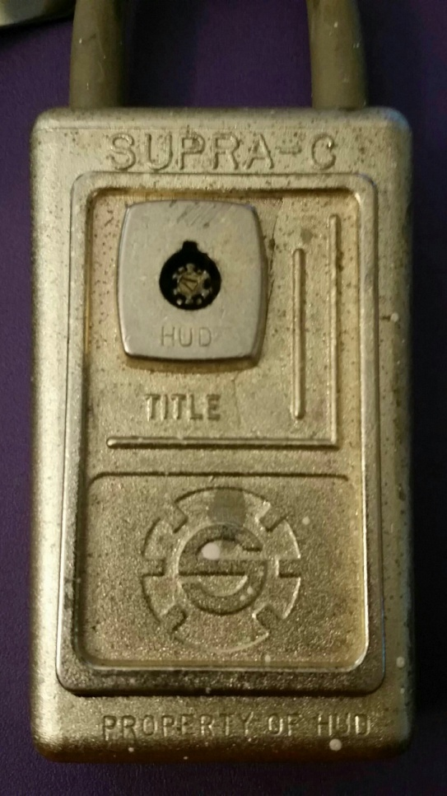
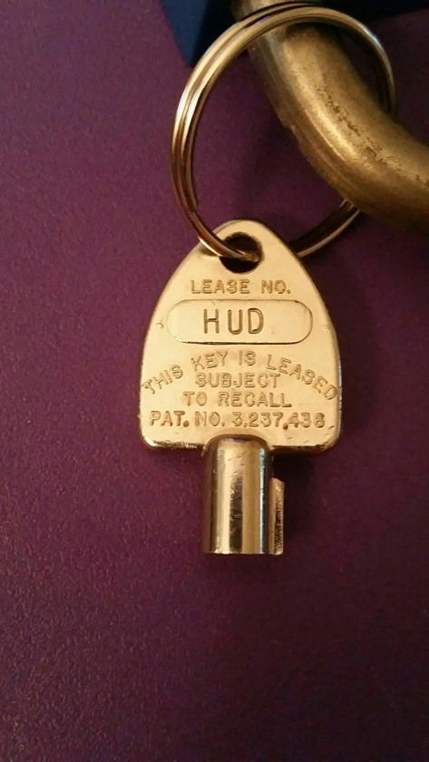
Rapid Access Competitors

Slide 43
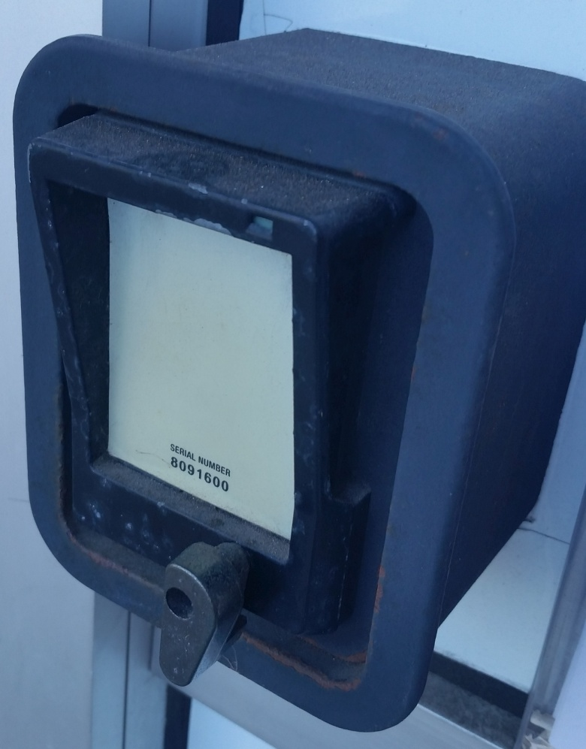

Rapid Access Competitors

